Slide 1

Jointly Optimized Regressors for Image Super-resolution
Dengxin Dai, Radu Timofte, and Luc Van Gool
Computer Vision Lab, ETH Zurich

Slide 2




The Super-resolution Problem
Noise
+
Blur and
Decimation
≈
Interpolate: align coordinates
Super-resolution: high-freq. content
Recover the HR image from the LR one
Notes:
We are often encounter the problem of converting images of different resolutions?
Converting images from HR to LR is very straightforward, however, the reverse is more challenging, SR is a filed to solve this reverse problem

Slide 3

Why Image Super-resolution?
(1) For good visual quality
This kitten made out of legos? They aren’t cuddly at all!
This kitten is adorable! I want to adopt her and give her a good home!
Image source: http://info.universalprinting.com/blog/

Slide 4
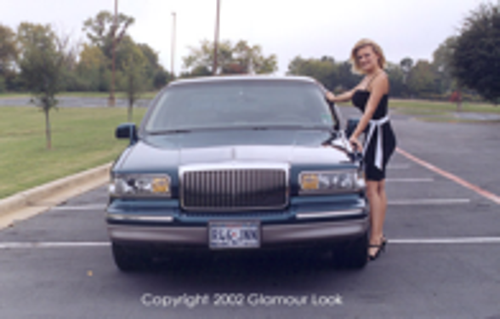
Why Image Super-resolution?
(2) Pre-processing component for other computer vision systems, such as recognition
Features & models are often trained with images of normal resolution
Low-resolution
Super-resolution result

Slide 5

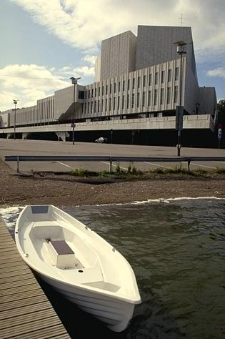
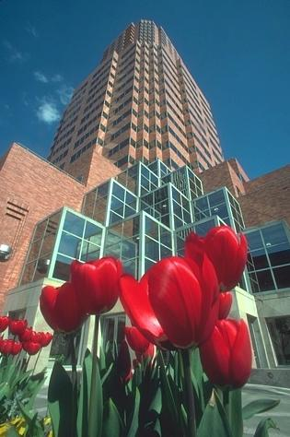







Example-based approaches
Core part: learning
Training examples
Input
Output
Ground truth
Not available during testing
Highly ill-posed problem
Notes:
Our approach falls into this category, so I will present the common pipeline which is also used by our method, and then present our contributions

Slide 6




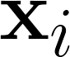
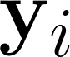
Core idea – patch enhancement
Learning transformation function for small patches
Less complex, tractable
Better chance to find similar patterns from exemplars
Patch
enhance
Interp.
& average
Input
Output

Slide 7

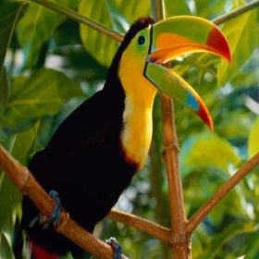







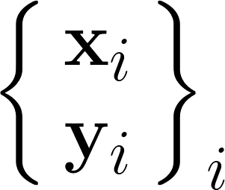




Training data
Training pairs (easy to create)
…
…
HR images
LR images
Feature Extraction (LR)
Matching
patch-pairs
…
Learning
Feature Extraction (HR)
Notes:
How to generate LR images from HR images？
We first present feature extraction , and then learning part.

Slide 8


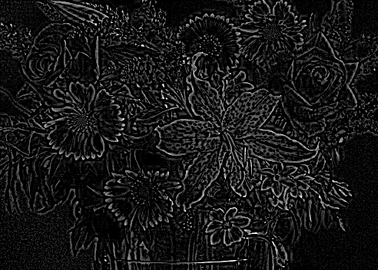
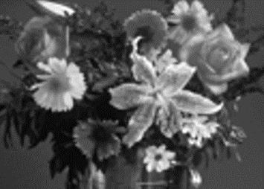
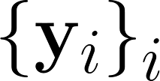
Training the Dictionaries – General
Feature extraction (HR)
HR
LR
High-Freq.
Interpolate
Down-sample
Patch Size: 6x6, 9x9 or 12x12

Slide 9


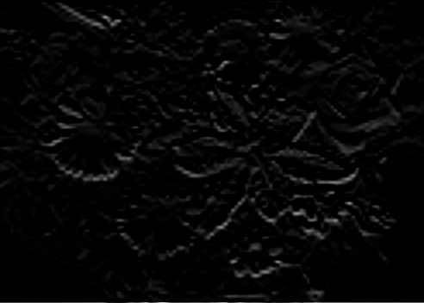

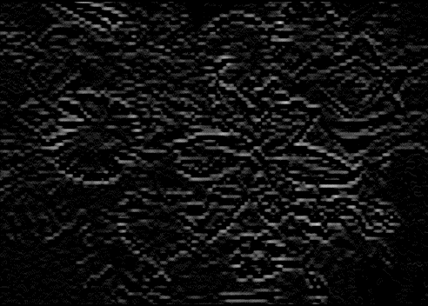
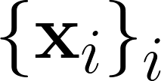
Training the Dictionaries – General
Feature extraction (LR)
HR
LR
1
0
-2
0
1
1
0
-1
1 | 0 | -1
1 | 0 | -2 | 0 | 1
Gradient
Laplacian
Interpolate
Down-sample
Patch Size: 6x6, 9x9 or 12x12

Slide 10
Training the Dictionaries – General
Learning methods
The transformation from LR patches to HR ones：
Related Work:
kNN + Markov random field [Freeman et al. 00]
Non-parametric
Neighbor embedding [Chang et al. 04]
Computationally heavy
Support vector regression [Ni et al. 07]
A highly non-linear function
Deep neural network [Dong et al. 14]
Complex optimization
Simple functions [Yang & Yang 13]
A set of local (linear) functions
Anchored neighborhood regression [Timofte et al. 13]
Efficient, but regressors learned separately

Slide 11
Training the Dictionaries – General
Differences to related approaches
Methods | Simple functions [Yang & Yang 13] and ANR [Timofte et al. 13] | Ours
Goal | A set of local regressors | A set of local regressors
Partition space | LR patches | Regression functions
Regressors | Learned separately | Learned jointly
# of regressors | 1024 (typical) | 32 (typical)
Notes:
Comparison side by side : # of regressors, way to partition the space

Slide 12
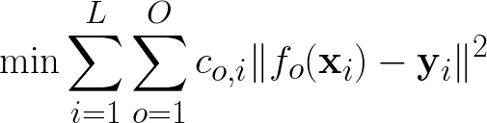
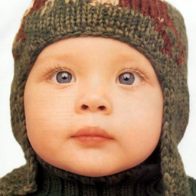
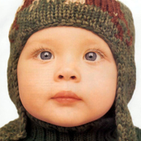
Training the Dictionaries – General
Our approach – Jointly Optimized Regressors
Learning: a set of local regressors, collectively yield smallest error for all training pairs
Individually precise
Mutually complementary
Testing: each patch is super-resolved by its most suitable regressor, voted by nearest neighbors
Regressor 1
Regressor 2
…
Regressor O
input
output

Slide 13
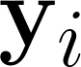

Training the Dictionaries – General
Our approach – learning
Two iterative steps (similar to k-means):
Update step: learn repressors to minimize the SR error of all pairs of each cluster
Assignment step: assign each pair to the regressor yielding the least SR error
Initialization: separate matching pairs into O clusters
…
…
…
HR
…
LR
…
…
…
Cluster 1
Cluster 2
Cluster O

Slide 14
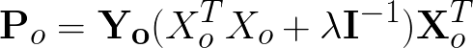
Training the Dictionaries – General
Our approach – learning
Update step: learn a regressor per group by minimizing the SR error
Ridge Regression:
…
…
…
HR
…
LR
…
…
…
…
Regressor 1
Regressor 2
Regressor O

Slide 15
Training the Dictionaries – General
Our approach – learning
Assign. step: assign each pair to the regressor yielding the least SR error
…
…
…
HR
…
LR
…
…
…
Cluster 1， Regressor 1
Cluster 2
Regressor 2
Cluster 3,
Regressor 3
SR error
Update step
Assign. step
Until convergence (~10 iterations)
Re1
Re2
Re3
Re4
Re5

Slide 16
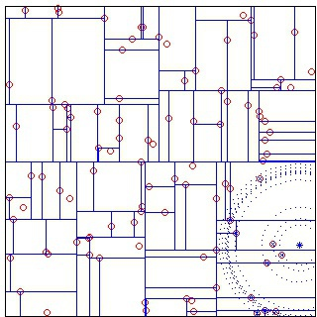
Training the Dictionaries – General
Our approach – learning
5 million patches
HR
LR
…
SR error
After iterations, each LR patch is associated with a vector indicating the SR error by each of the O regressors
kd-Tree
[Vedaldi and Fulkerson 08]

Slide 17

Training the Dictionaries – General
Our approach – testing
LR
Similar patches share regressors
filtering
interpolate
search kNN
LR
SR error
vote
Re1
Re2
Re3
Re4
Re5
input
Regressors
Kd-Tree

Slide 18

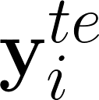
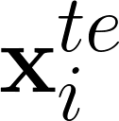
Training the Dictionaries – General
Our approach – testing
LR
High-Freq.
=
Average
Regressor 3
Ridge Regression
interpolate
input
output
Notes:
Replace the image

Slide 19
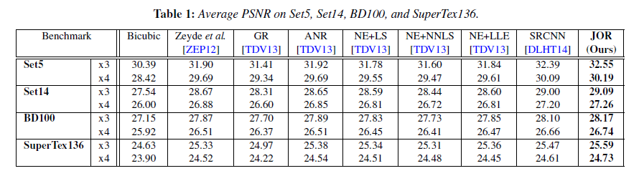
Results
Compared with 7 competing methods on 4 datasets (1 newly collected)
Our method, yet simple, outperforms others consistently
Average PSNR (dB) on Set5, Set14, BD100, and SuperTex136
Notes:
Compared to regressor-based approaches
We are around 0.1 dB better than SRCNN
Dataset: two typical, segmentation 5 and 14, Berkeley dataset, in addition to this, we propose a new dataset with 136 texture
Why the texture dataset?

Slide 20
Results
PSNR (dB)
PSNR (dB)
The number of iterations
The number of regressors
Better results with more iterations
Better results with more regressors

Slide 21
Results
PSNR (dB)
The number of training patches
Better results with more training patch pairs
Notes:
Performance gain for limited number of training patches
Complexity
Type some text

Slide 22
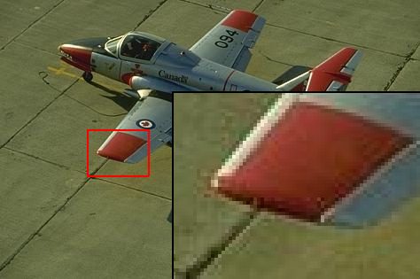
Ground truth
/ PSNR
Factor x3

Slide 23

Bicubic
/ 27.9 dB
Factor x3

Slide 24

Zeyde et al. /28.7 dB
Factor x3

Slide 25

SRCNN
/29.0 dB
Factor x3

Slide 26

JOR
/29.3 dB
Factor x3

Slide 27
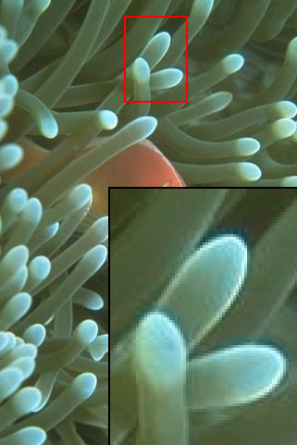


Results: factor x4
Ground truth / PSNR
SRCNN/ 31.4 dB
JOR / 32.3 dB

Slide 28
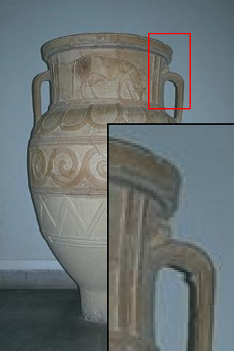


Results: factor x4
Ground truth / PSNR
Bicubic / 32.8 dB
JOR / 33.7 dB

Slide 29
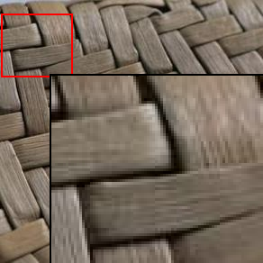
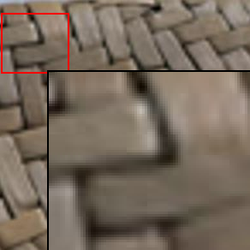




Results:
factor x4
Ground truth / PSNR
Bicubic / 25.5 dB
Zeyde et al. / 26.7 dB
Bicubic
ANR/ 26.9 dB
SRCNN / 27.1 dB
JOR / 27.7 dB

Slide 30
Conclusion
A new method by jointly optimizing regressors with the ultimate goal of ISR
The method, yet simple, outperforms competing methods
The code is available at www.vision.ee.ethz.ch/~daid/JOR
A new dataset, 136 textures evaluating texture recovery ability

Slide 31
Thanks for your attention!
Ground truth / PSNR
Bicubic / 31.2 dB
SRCNN / 33.3 dB
JOR / 34.0 dB
Questions?

Slide 32
Reference
Dai, D., R. Timofte, and L. Van Gool. "Jointly optimized regressors for image super-resolution." In Eurographics, 2015.

